Slide 1

Progress Seminar on Anymo – Anonymous Posts and Chats
Presented By
Vedant Chimote
Tushar Wath
Sachin Khadse
Noor Mohammad Siddiqui
Guided By
Mr. Ashish Labade
Department of Computer Science & Engineering
S. B. JAIN INSTITUTE OF TECHNOLOGY MANAGEMENT AND RESEARCH,NAGPUR
An Autonomous Institute, Affiliated to RTMNU, Nagpur

Slide 2
Contents
Problem Statement & Objectives
Introduction
Literature Survey
System Design
Proposed Work
Technology to be Use
Advantages & Applications
Plan of Work
References
2
S. B. Jain Institute of Technology Management and Research

Slide 3
Problem Statement & Objectives
Problem Statement :
Objectives
To provide basic social media features like posting, liking on the posts as well as commenting and one-to-one chatting
As the specialty of application, the posting should be anonymous as user’s real identity will be hidden
Provide content moderation to control the types of contents that are posted by users be suitable for the normal users to maintain a healthy social environment
Developing an android based social media platform (Android Application) for anonymous posting and chatting.
3
S. B. Jain Institute of Technology Management and Research

Slide 4
Introduction
As social media use continues to grow, and details of many people’s lives are becoming publicly accessible online, a clear division is forming between two types of people; those that seek to release as much information about themselves into the digital realm as possible and those that seek to protect their personal information.
With this divide growing, so is the use of anonymous chat apps which have been exploding in recent times. Popularized for their ability to connect users without revealing their true identities, anonymous chat apps provide the perfect platform to securely share private information about yourself without the worry of potential hackers being able to know that it is your information.
Taking it one step further, they’re various services that collect as little information about you as possible, from account set-up to usage data. So, even if security is compromised for any given reason, it’s hard for an attacker to identify you. Therein lies the beauty of the concept!
Similarly, The Anymo android based application focus on the publishing of text and graphic information anonymously. Users can post anonymously, write anonymously comments, and have one-to-one anonymous chats. The post feed is based on device geolocation to make it easier for users to find anonymous posts in their region.
S. B. Jain Institute of Technology Management and Research
4

Slide 5
Literature Survey
Websites / Paper / Article | Reviews / Findings
https://bfsi.eletsonline.com/social-media-and-privacy-risk/ | The most important issues surrounding the use of social media is privacy and security. And the same has been increasing these days in a terrifying manner. It has become so dangerous that if you somehow cross your red line, there are chances that you are putting yourself, your organization/ business and even your country at large at a huge risk. There are hundreds of black hats waiting outside to exploit even the slightest mistake that we may do while using those platforms.
https://www.politics.co.uk/comment/2021/03/10/why-we-should-preserve-anonymity-on-social-media/ | The argument for anonymity on social media is important because it is this that allows individuals to freely express themselves without fear of repercussion. Whistleblowers also rely on anonymity to voice their concerns while ensuring they won’t lose their jobs or, depending on the government, be subject to criminal punishment or even death.
S. B. Jain Institute of Technology Management and research
5

Slide 6
Literature Survey
Websites / Paper / Article | Reviews / Findings
https://blogthinkbig.com/the-power-of-secrets-anonymous-social-networks-start-to-spread | The distrust generated by the potential repercussions of the tracking of our digital footprints on the internet – after years of social networks uploading personal data of our daily lives – has prompted thousands of users to shift over to anonymous social networks. Whisper and Secret are two of these applications that allow users to continue to be social, but with complete anonymity, and without real data.
https://www.livemint.com/opinion/columns/anonymity-on-social-media-and-its-ugly-consequences-11612977615856.html | Digital platforms are being used for many other ills, too, such as spreading fake news and trolling one’s opponents. In recent times, digital media has been used to incite many a violent act in the physical world too. Digital media giants have been experimenting with multiple ways to filter out or label negative or misleading posts. But they have not had much success. Many observers are worried that these trends could affect digital media’s image and harm its future.
S. B. Jain Institute of Technology Management and research
6

Slide 7
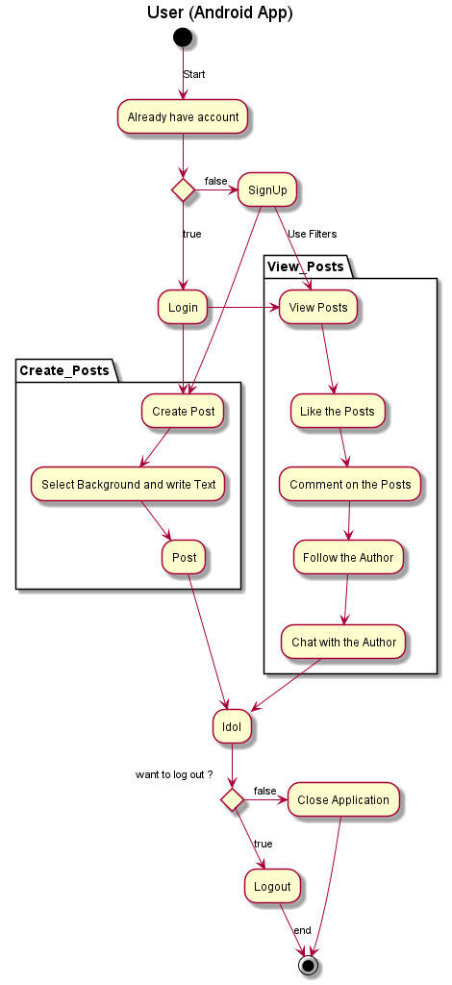
System Design: Flowchart
S. B. Jain Institute of Technology Management and research
7

Slide 8
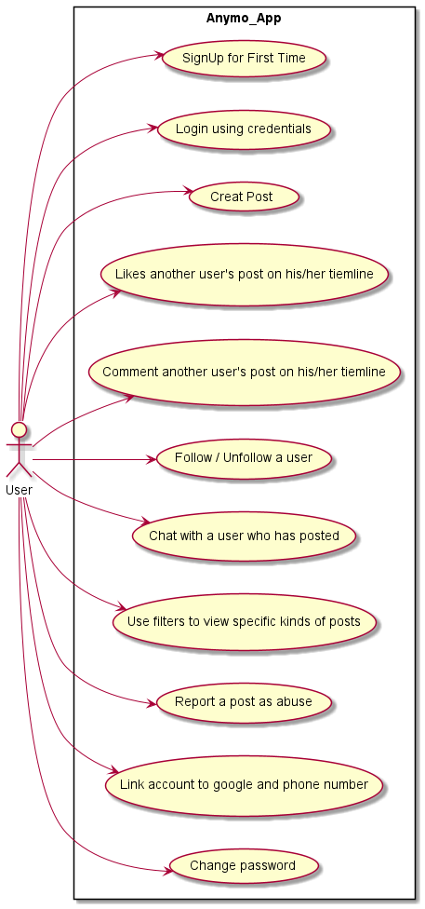
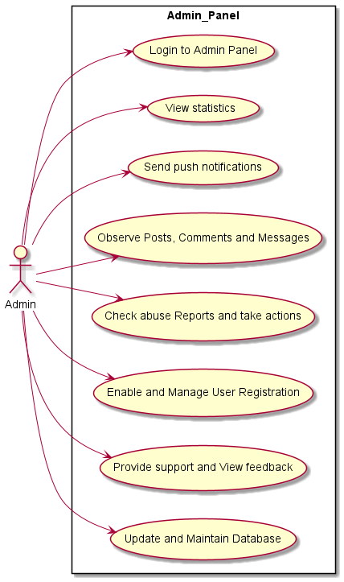
System Design: Use Case Diagrams
S. B. Jain Institute of Technology Management and research
8

Slide 9
Proposed Work
The basic intent of our project is that the users should be able to post and chat anonymously on the huge social media platform without exposing their true identity. The application will be a simple chatting and posting android application yet user friendly.
The role of the users with the application is started with the user sign up with a phone number or the email address (which won’t be disclose) to anyone and anywhere. As the user sign in, he is free to view the other users (author) posts as well as create new beautiful posts by selecting the background as a background image or just a simple solid background color along with the text color.
The chat application itself is very simple in that it enables users to quickly chat with strangers online without giving up any kind of personal details. This gives users peace of mind which allows them to concentrate on having a good conversation with a stranger rather than worrying about who’s doing what with their data.
The chatting features and user interface is inspired from Instagram, While chatting user can send images, text, camera captured images, and stickers also videos in further update. User can delete the message from both the ends as in Instagram.
S. B. Jain Institute of Technology Management and Research
9

Slide 10
For better utility the app provide the dark mode feature making it usable in night time without having strain on eyes.
The app has an effective notification mechanism to receive notifications about the posts from the followed author, messages from strangers or already interacted user.
As for safety concern, the user can post only 10 (as defined) posts per day forcing the user to post only meaningful posts and the message on the posts has the maximum size of 150 words (as defined) or enough to cover the card for concise yet meaningful posts.
There are of course inherent downsides to such communication or sharing of images, videos, information with complete strangers.
Reporting the post to the admin , Abuse check before final posting and daily limited posts by an individual also unfollowing an author whose posts doesn’t seem to be appropriate and ultimately banning the user IP will help in controlling the exploitation of the service.
The admin will have access to the observe posts and comments and right to remove them if he find them inappropriate. Even he can block a user and permanently disable his/her account.
S. B. Jain Institute of Technology Management and Research
10

Slide 11
Module 1: Information Gathering and Implementing basic features in user android app and testing
It includes creating basic activities and features like splash screen, user registration, generating basic ui, creating posts with libraries like card view, colorpicker, blurry, picasso.
Module 2: Creating the web based admin panel along with sql database and testing
It includes creating Anymo’s admin panel and APIs for linking the client with server and database. The admin will have a basic dashboard showing statistics about the no of Total Users, Total secrets, Total Comments and Total Messages. Push notification to send message to all users or specific individuals. The admin can check the posts which are reported as abuse in specific category. With admin panel we can check the feedback, and provide support as demanded. The database used is a SQL database with version 5.5 to provide the emoji support. We have hosted the admin panel on Linux web hosting with domain ioptimus.me.
Module 3: Adding extra features and testing
It include the one-to-one chatting via client, using geolocation services to allow to view the posts in the radius in Kms. To maintain healthy platform, we have provided the abuse report feature, to discard the posts which aren’t suitable for mass community. Continuously new features are adopted and tested.
S. B. Jain Institute of Technology Management and Research
11

Slide 12
Module 4 : Content Moderation
In this module, we focused on the content moderation by adding features like post report to admin for particular reason as specified within the client, followed by admin’s action to the reported posts and blocking the user’s account and ip address.
Adding Reports table to Database.
Module 5 : Adding new features and testing
We will be adding the new features like posting videos along with pictures, embed YouTube videos, OTP verification, restricting the user to post only 10 posts per day and encryption on the chat messages

Slide 13
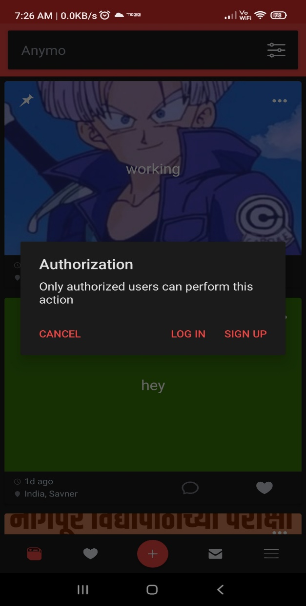
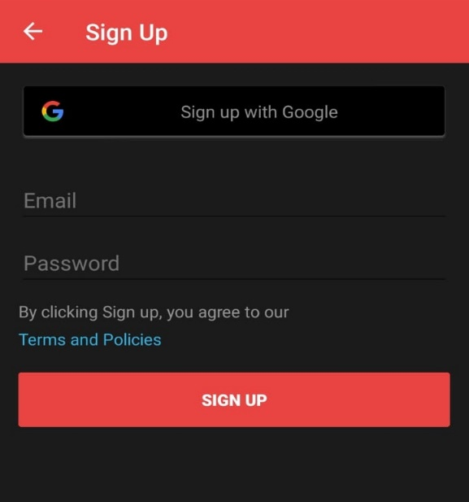
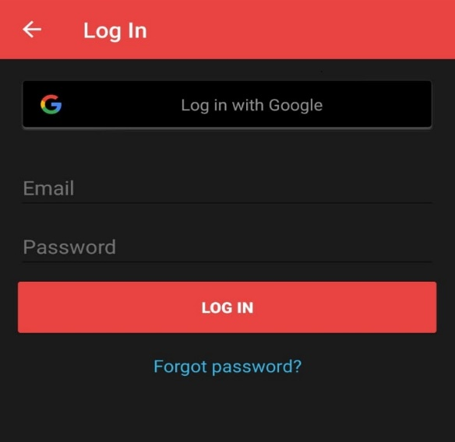
As user installs and opens the application for first time
Login screen
For performing basic activities like creating new post, liking and commenting on existing post, application asking for signup or login
Signup page

Slide 14
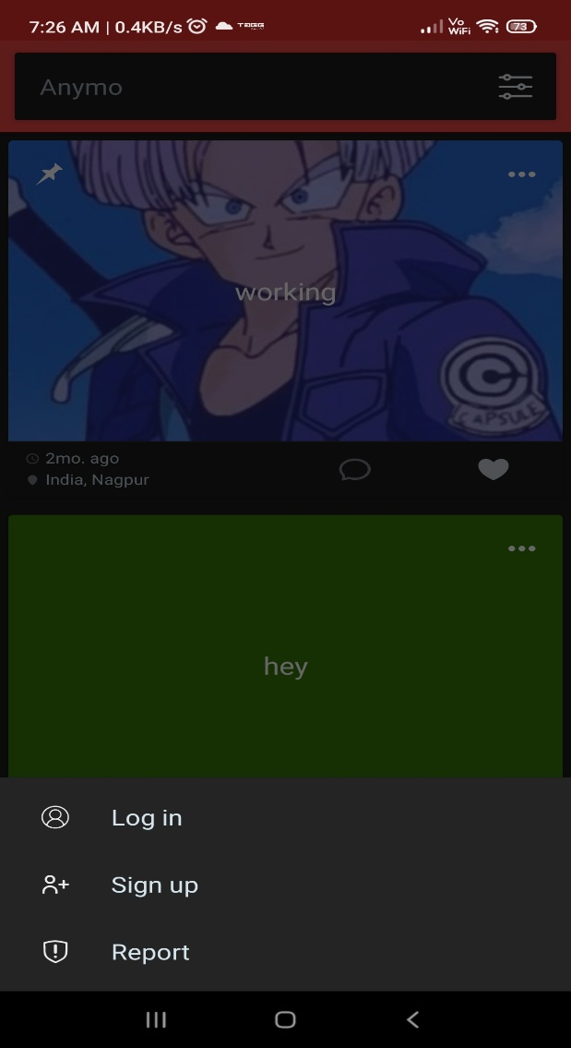
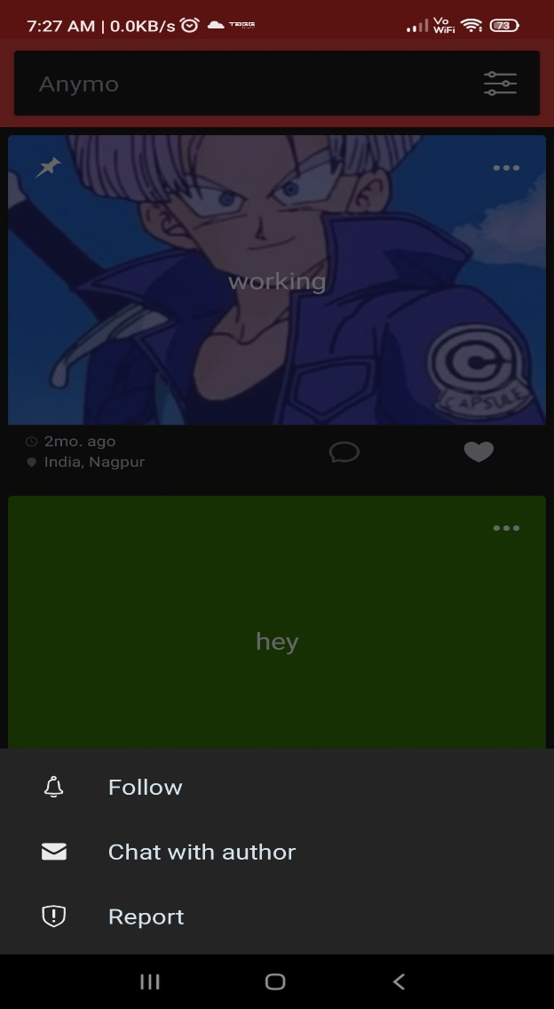
As user find’s any post as inappropriate, he can report the post to the admin
If user not logged in
If user logged in

Slide 15
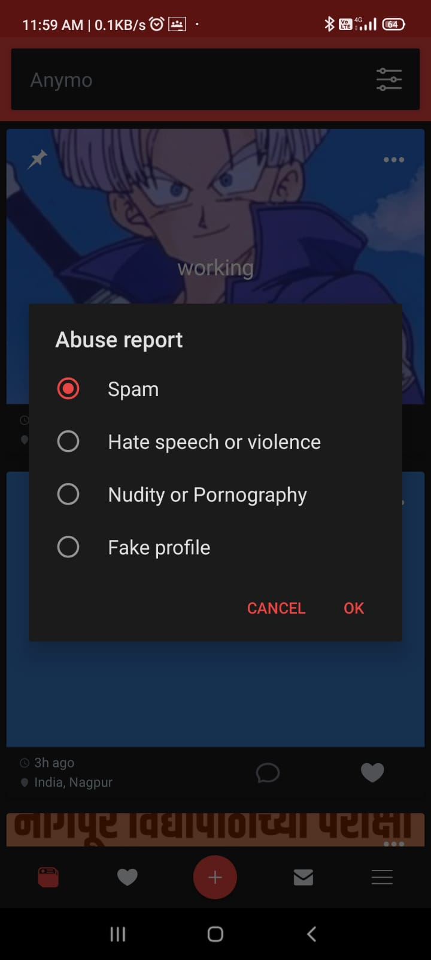
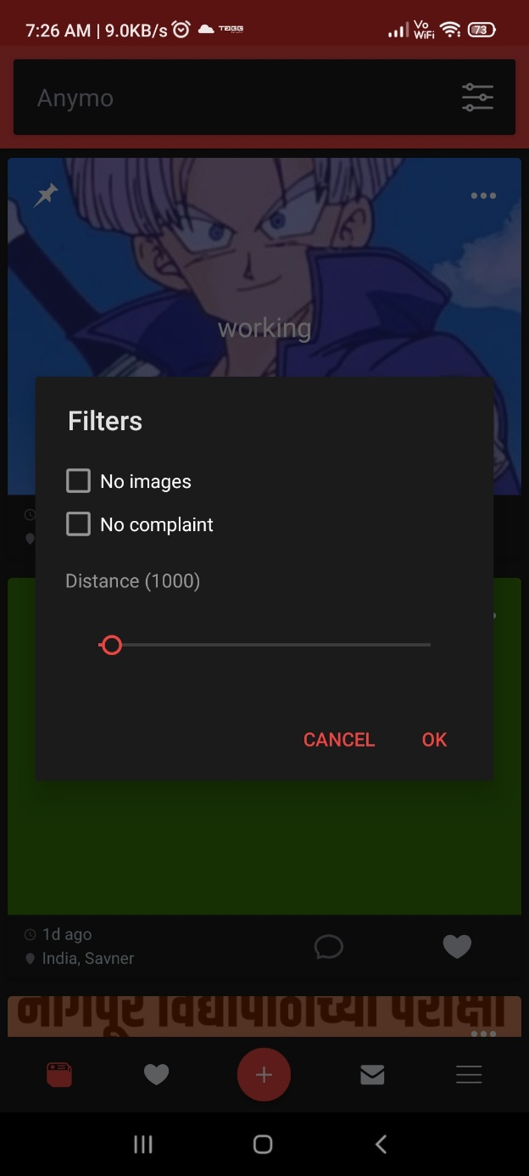
Abuse report can be done by the following reasons by users
In order to filter the posts that are already been reported by existing users, we can filter those posts by checking on the No Complaint box

Slide 16
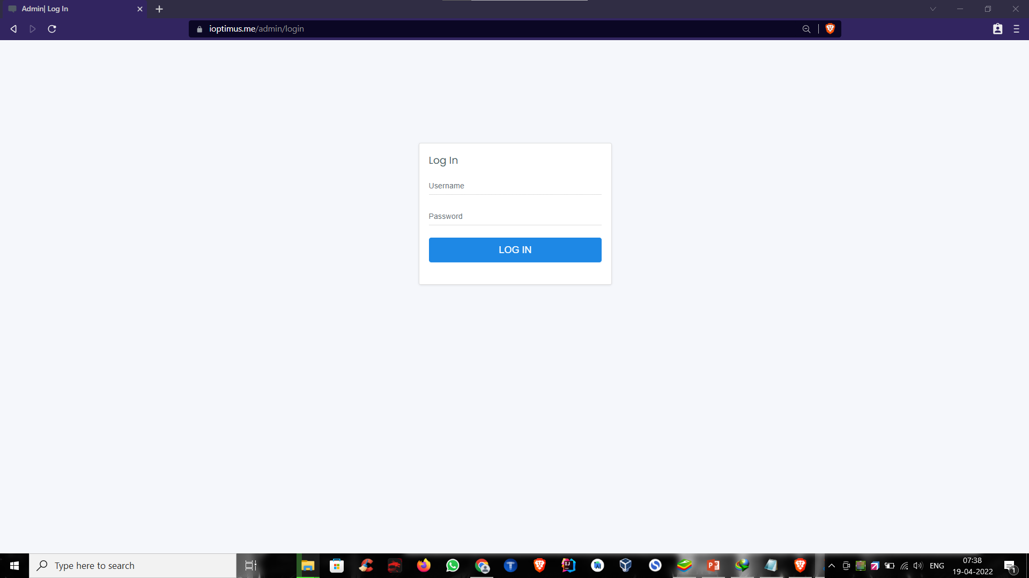
Admin Login Page

Slide 17
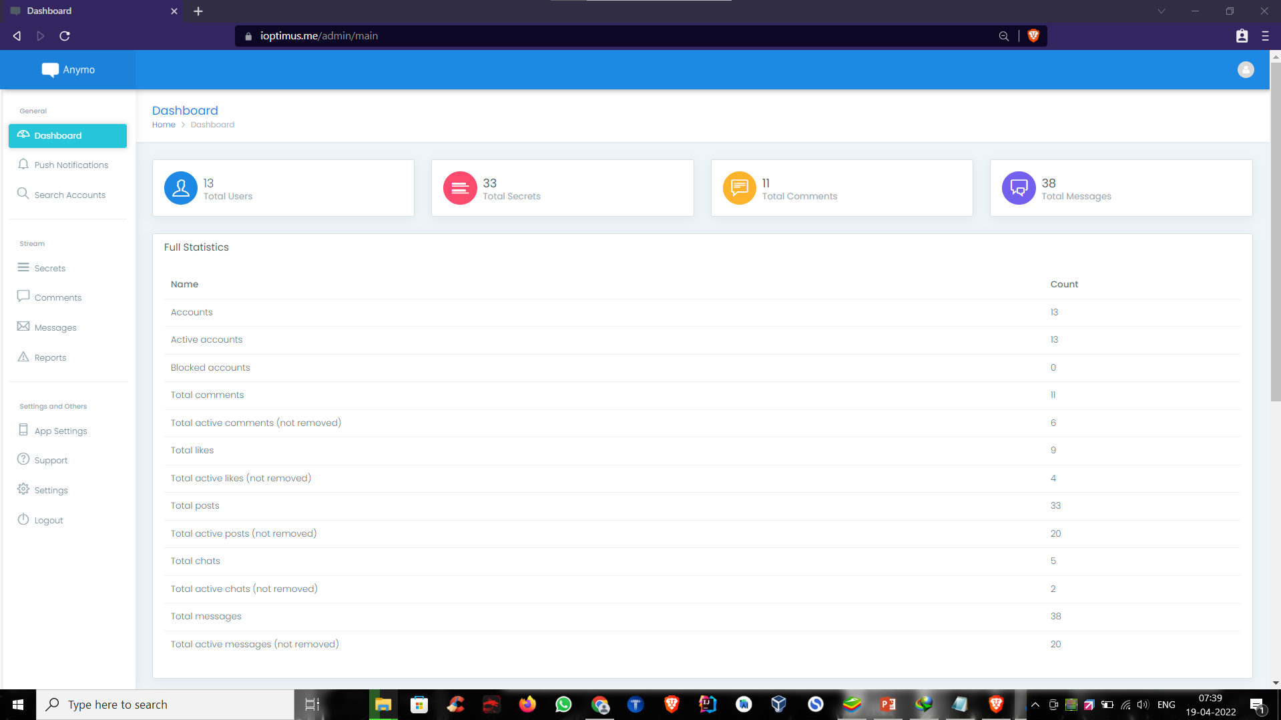
Admin Dashboard

Slide 18
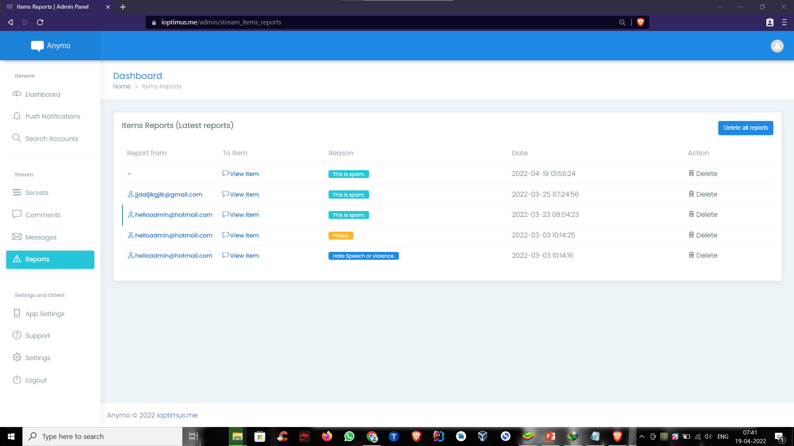
Admin can view the posts that are reported by users and take required action

Slide 19
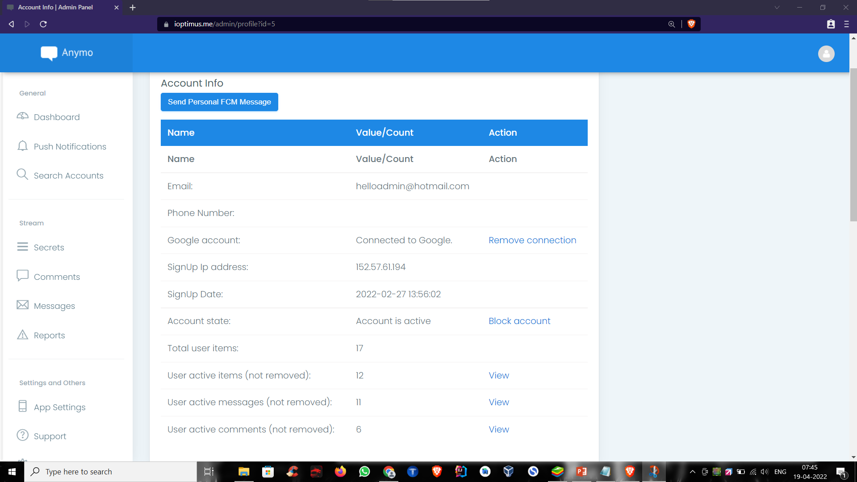
Admin can inspect the users activities, so admin can observe the specific user whose posts are reported frequently and consequently block his account , also delete the user directly from DB

Slide 20
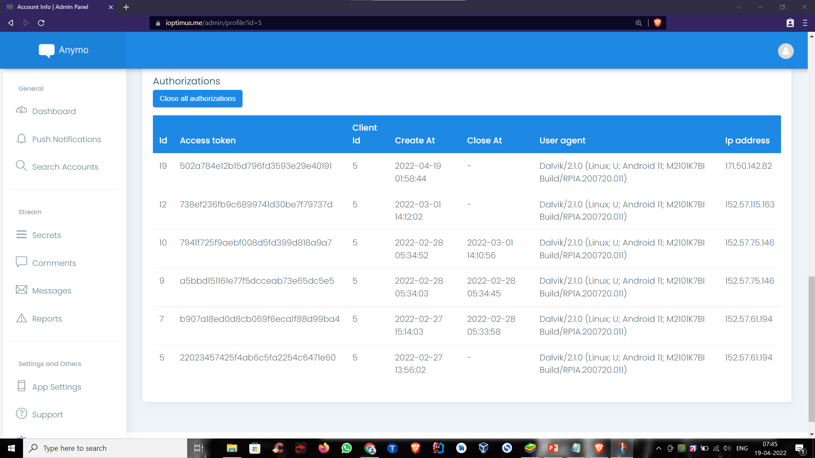
Admin can close the user’s authorizations (Logins), followed by blocking his account

Slide 21
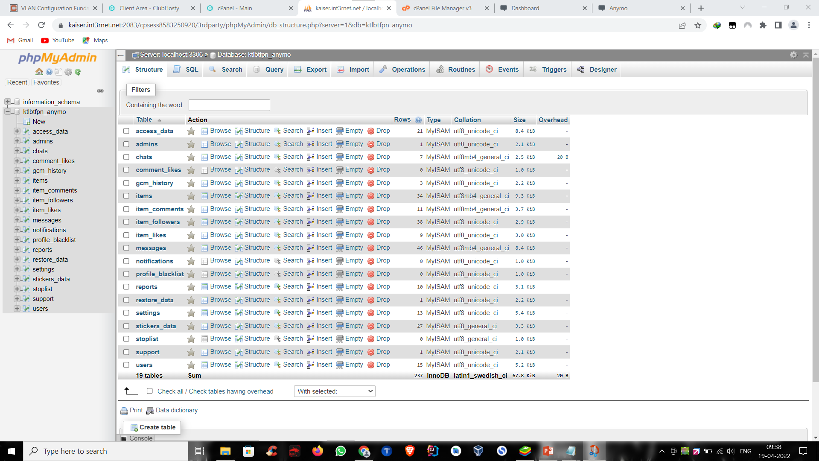
Anymo’s Database

Slide 22
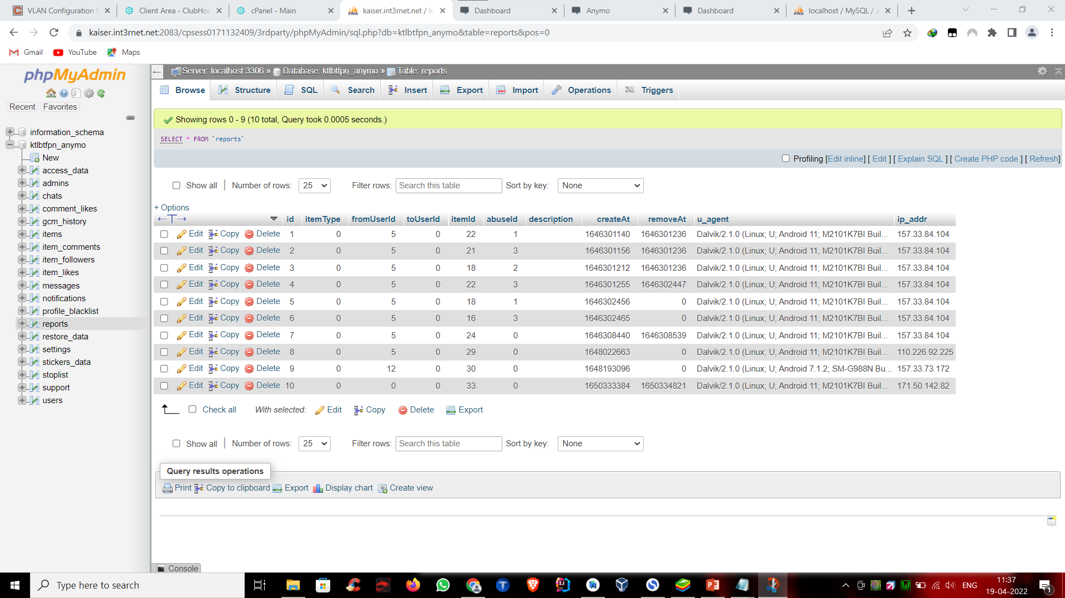
Reports Table – To maintain the registry of the user’s posts that are reported and by whom

Slide 23
Technology to be Used
Android
Java, MVC Pattern
Library/API/Framework: Firebase Push Notifications, Google login, OTP verification (SMS), volley, okhttp, mediarouter, firebase analytics, firebase auth, google emoji, photoview, recyclerview, cardview, Google Play Location Service, Xml, Firebase, Google Cloud API Services, Location API,
Picasso, glide, firebase messaging, exifinterface, blurry, Vectordrawable and WebView.
Compile Sdk Version 29 compatible with android 12
Web
Front End:
HTML, CSS, JS
Back End:
PHP (Without Using Framework), Compatible with PHP 7.x and 8.x, MySQL 5.5, PhpMyAdmin, Admin Panel hosted on Linux based Web Hosting
IDE:
Android Studio , VS Code , Bluestacks Emulator
Hardware used:
PCs with Windows 10 OS, Linux Server
S. B. Jain Institute of Technology Management and Research
12

Slide 24
Advantages & Applications
With Anymo, users can interact with unknown people across the world
Users will make anonymous friends or chat with random people in the application
Users can share files and high-resolution photos
Users will freely post text or graphical posts without caring about other’s judgement
Users can use it for one-to-one chatting as alternative to Instagram and Facebook
With Geolocation feature, Users can filter the visible posts in their timeline by selecting the distance in Kms
Users can select to block the posts which are already reported as abusive
Users can ask for help to strangers if they feel unconfident while asking
Whistleblowers can leak vital information that should be known to mass people, safely
For feedback purpose, where users can provide the honest opinions secretly without any hesitation and fear
S. B. Jain Institute of Technology Management and Research
24

Slide 25
Plan of Work
Work | Time (Days) | Status
Requirement Gathering (Project) | 2-3 | Done
Analysis (Project) | 1-2 | Done
Requirement gathering & Analysis (Module1) | 3-4 | Done
Implementation (Module1) | 7-10 | Done
Testing (Module1) | 2-3 | Done after implementation of module 1
Requirement gathering & Analysis(Module2) | 7-8 | Done
Implementation (Module2) | 5-6 | Web based admin panel with development of SQL database
Testing (Module2) | 2-4 | Done
Report Generation &Submission | 2-5 | After Successful completion of above modules
Requirement gathering & Analysis(Module3) | 4-7 | Done
Implementation (Module3) | 6-10 | One-to-one chatting, geolocation based post, content moderation
Testing (Module3) | 3-10 | Done
Report Generation &Submission | 2-4 | After Successful completion of above modules
S. B. Jain Institute of Technology Management and Research
25

Slide 26
References
Websites:
https://theconversation.com/anonymous-apps-risk-fuelling-cyberbullying-but-they-also-fill-a-vital-role
https://www.privacyend.com/guides/best-anonymous-chat-apps-android/
https://www.betterhelp.com/advice/chat/pros-and-cons-of-an-anonymous-chat-room/
https://www.forbes.com/sites/capitalone/2017/09/28/anonymous-messaging-apps-is-honesty-really-the-best-policy/?sh=6a2819b93c75
https://www.betterhelp.com/advice/chat/pros-and-cons-of-an-anonymous-chat-room/
https://www.regain.us/advice/chat/the-benefits-and-cautions-of-anonymous-chat/
https://ciphr.io/blog/post/anonymous-chat-app
S. B. Jain Institute of Technology Management and Research
26

Slide 27
Thank You
S. B. Jain Institute of Technology Management and Research

